Slide 1
Week 8 Modalities

Slide 2
Administrivia

Slide 3
Gestural Query Specification
Arnab Nandi, Lilong Jiang, Michael Mandel
The Ohio State University
Presented by Carmine Elvezio
Columbia University - 03/12/2020
Systems for Human Data Interaction

Slide 4
Motivation
End-User friendly interaction with Databases
Next-generation computing devices
Natural User Interaction with Data
Hand, eye, voice-based interactions instead of mouse-based interaction
Notes:
New types of interaction technologies and techniques possible, including touch screen hand tracking, eye tracking, voice input.
This allows for the possibility of breaking from older modalities like typing only or mouse-based.
User-friendliness is important, for novice users especially

Slide 5
Motivation
Use gestures to perform database queries
Guide users to exact query intent and intended result
Give users feedback as they make queries
Support: Direct Manipulation, Closure and Composition, Expressivity
Notes:
Gestures can utilize Natural User Interface designs to help
Need to help guide users to that point
Users need feedback as they do these queries
Allow for direct manipulation, always being able to get to a query from the current query, coverage of what a person may want to do with SQL

Slide 6
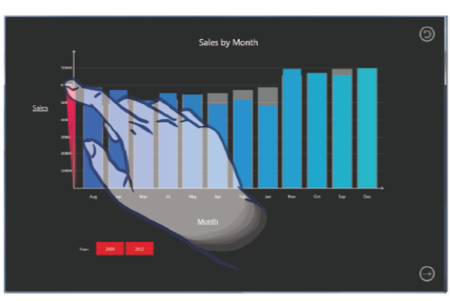
Related Work
Nandi and Jagadish: Guided Interaction (VLDB 2011)
Use interaction to guide user through query formation
Drucker et al.: TouchViz (CHI 2013)
Comparison of mouse-styled tap interfaces vs gestural interactions
Nandi, Arnab, and H. V. Jagadish. "Guided interaction: Rethinking the query-result paradigm." Proceedings of the VLDB Endowment 4.12 (2011): 1466-1469.
Drucker, Steven M., et al. "TouchViz: a case study comparing two interfaces for data analytics on tablets." Proceedings of the SIGCHI Conference on Human Factors in Computing Systems. 2013.
Notes:
Nandi, the author of this paper, wrote about the notion of guided interaction to help users form queries. It is a feeder paper to this.
Later Drucker creates a tablet interface that would look at two modalities for interacting with touch: tap based and gesture based. This showed the advantages of gestures.

Slide 7
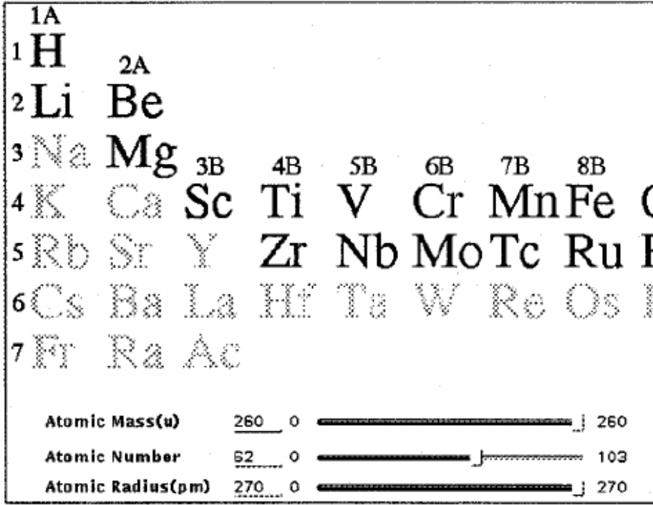
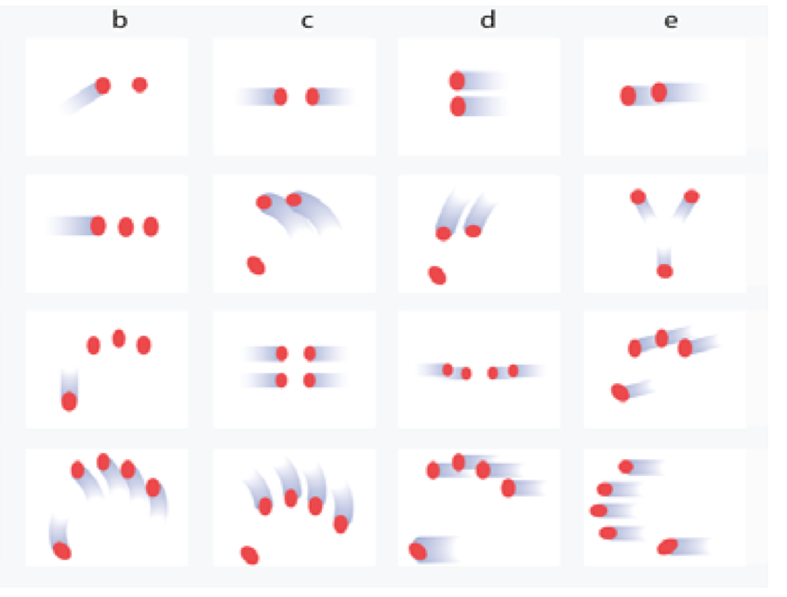
Related Work
Schneiderman et al.: Dynamic queries: database searching by direct manipulation (CHI 1992)
Physical action changes query
Damaraju and Kerne: Multitouch gesture learning and recognition system (IEEE Workshop on Tabletops and Interactive Surfaces 2008)
System that learns and recognizes multitouch gestures
Shneiderman, Ben, Christopher Williamson, and Christopher Ahlberg. "Dynamic queries: database searching by direct manipulation." Proceedings of the SIGCHI conference on human factors in computing systems. 1992.
Damaraju, Sashikanth, and Andruid Kerne. "Multitouch gesture learning and recognition system." Extended Abstracts of IEEE Workshop on Tabletops and Interactive Surfaces 2008. 2008
Notes:
In the 90s, Scheiderman looks at an interface for directly interacting with data using interface elements like sliders
Damaraju and Kerne build a system that can learn new gestures, instead of having to build the detection logic hard coded.

Slide 8
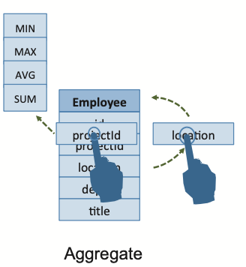
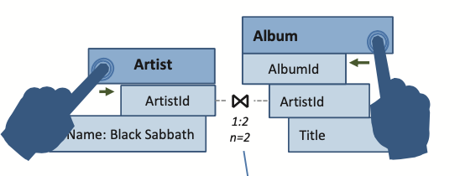
Challenges
Interaction is continuous
New paradigm - continuous interaction loop
Direct manipulation interface
Manipulate the data directly to get queries
Guide the user
Provide the user feedback
Notes:
unlike traditional keyboard interaction where the user types out a string of characters gestural interaction is expected to be fluid
users expect to manage, query, and manipulate data by directly inter- acting with it
There can be an infinite number of gestures, you need to guide them and provide feedback

Slide 9
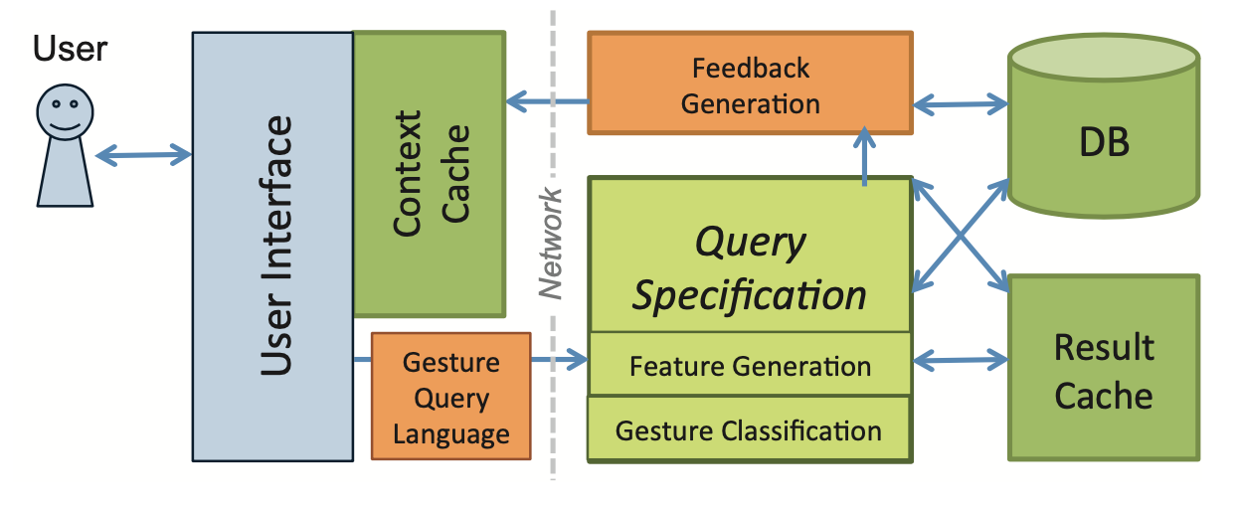
Contributions
Introduce and define: Gestural Query Specification
Novel querying framework
Details the architecture and implementation of GestureQuery
User Study evaluating GestureQuery
Notes:
“Gestural Query Specification” which focuses on how gestures can be articulated to query a database
A novel querying framework (which takes as input the gesture and tries to calculate and utilize query intent, context to generate the database queries)
The details of an architecture and implementation of GestureQuery (their implementation of the above ideas, combined with a classification system to discern query intent while utilizing user feedback, on top of a classification system to discern said intent)
User study evaluating GestureQuery showing that it was generally more effective and preferred to the Visual Query Builder system and textual input

Slide 10
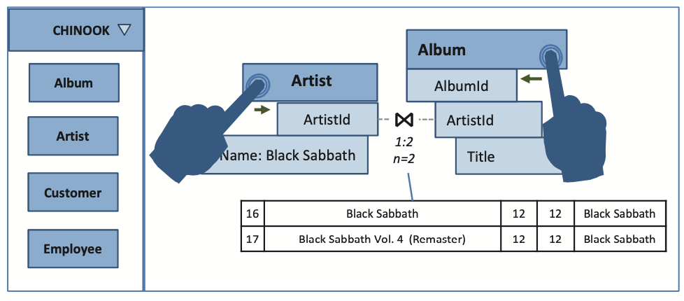
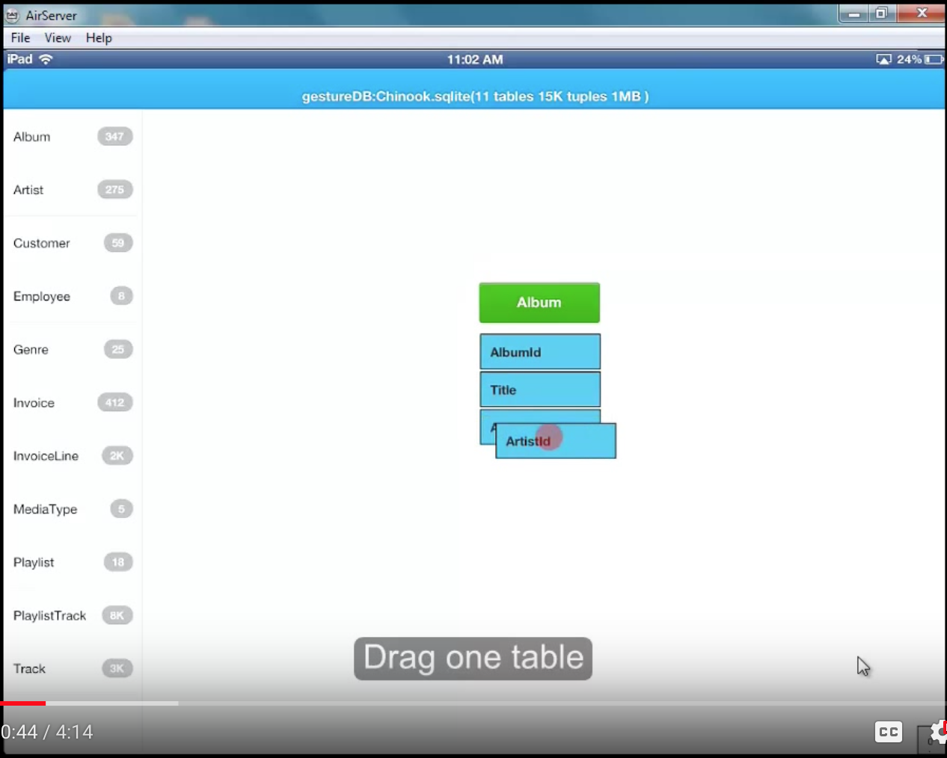
Example
“Find the titles of all of the albums created by ‘Black Sabbath’”
Difficulty: discovering schema, understanding query language, using system to get desired information
Filter: Drag Black Sabbath to attribute header
Join: Drag Artist and Album close
Notes:
Video link shows basic interaction

Slide 11
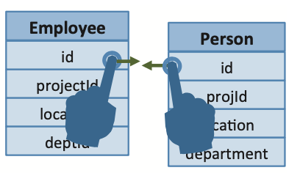
Gestures
Gestures are movements of the hand or body
Represented as time-series of points pi = ⟨t, l, m⟩
Movements are Gesture Articulations
Supports 3D
Notes:
T: timestamp of that point
L: locational information in the interface
M: Metadata associated with that point and time

Slide 12
Articulation to Query
Query Specification: Go from conceptual task to specifying corrected query
Query Intent: Probability Distribution over space of valid articulated queries
Query Context: Query intent transitions + recent intermediate results + feedback
Query Gesture: Set of gestures codified as pattern with “Likelihood score”
Notes:
Query Intent: Probability Distribution over space of valid articulated queries. The process of narrowing the query space and arriving at an explicit query is called a query intent transition.
Query Context: Due to the directly manipulable nature of the interface, the system catalogs all query intent transitions and all recent inter- mediate results and feedback
Each gesture maps to one or many parameterized queries. When the likelihood score for a certain gesture goes above a fixed threshold, the system attempts to pop- ulate the parameters of the parameterized query using the gesture information

Slide 13
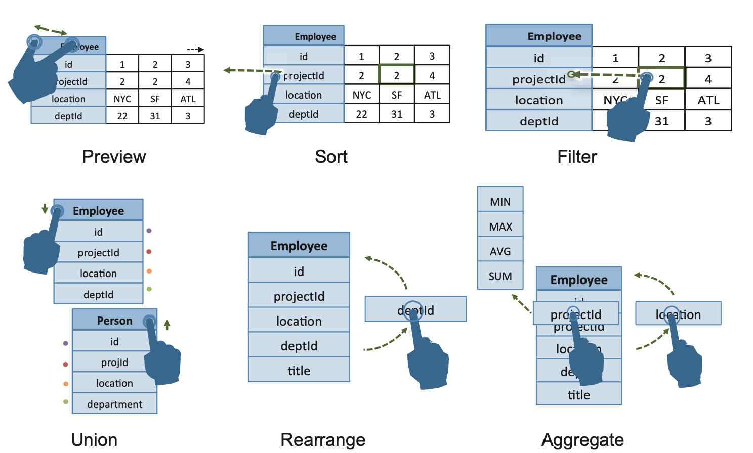
Interactions
Data Model: Paper uses relational model, but could be any
Support: Undo, Preview, Sort, Aggregate, Rearrange, Filter, Join, Union, Insert, Update, Alter, Projection
Notes:
System uses a relational model, but it doesn’t have to be that
Actions supported listed. With JOIN being the most important

Slide 14
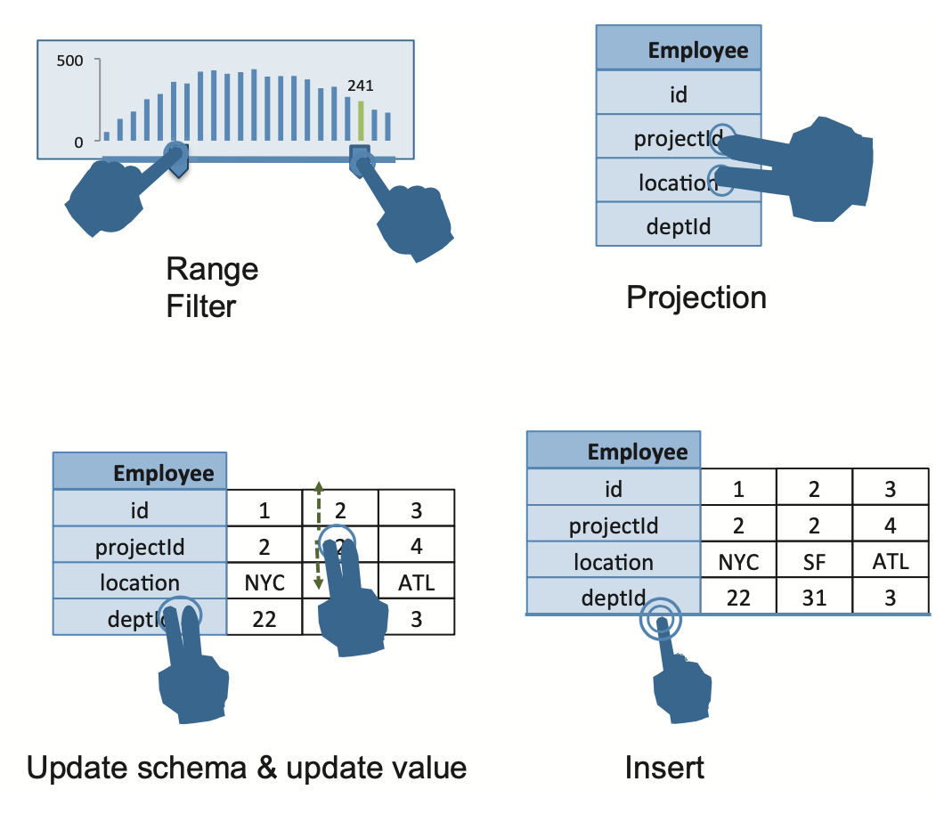
Interactions
Data Model: Paper uses relational model, but could be any
Support: Undo, Preview, Sort, Aggregate, Rearrange, Filter, Join, Union, Insert, Update, Alter, Projection
Notes:
Shake to preview, data can be rearranged, To unify tables, the user drags one table onto another from the top, in a stacking gesture, aggregate: The user first needs to drag the grouping attribute to the table header to bring up a popup menu of aggregate functions. The user then drags the aggregated attribute through the desired aggregation functions in the menu.

Slide 15
Interactive JOIN
We want to avoid MxN separate drag actions
Allow attributes to connect as user drags tables together
Use arc layout: readable and unambiguous
Notes:
Worst case: M Tables and N attributes

Slide 16
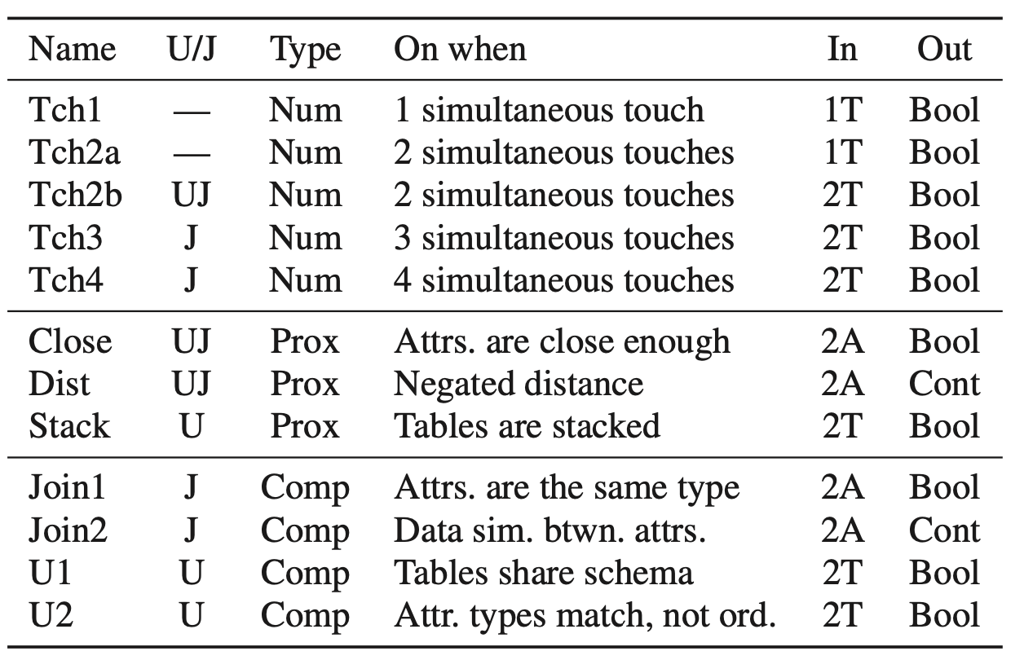
Classification
Classify Gestures using Proximity and Compatibility of tables involved
Use Maximum Entropy Classifier
Proximity: Spatial Information of UI
Compatibility: Schema info incl. matching field types and similar data
Notes:
Mathematically, the goodness g(q) of a potential query q with feature values fi(q)
Input to our classifier is similar to what is available on current multitouch mobile platforms. The UI layer will supply the classifier with a list of (x,y) coordinates and an ordinal identifier indicating the finger with which it is associated.
Lambda from training

Slide 17
Classification
g(q) is Goodness of query
fi(q) utilizes:
Proximity and Compatibility
Evaluate to −∞ or 0
Optimization: Skip calc when −∞
λ is extracted through training
Notes:
data similarity as a feature to aid multi-attribute queries such as joins. This feature is based on a probability distribution over histograms of join participation counts.
This histogram is then converted to a multinomial distribution and its probability is measured under a dirichlet distribution.

Slide 18
User Study
Completion Time:
GestureQuery outperforms Visual Query Builder and Console
Notes:
GESTUREQUERY’s average completion times are lower and have less variance than both CONSOLE-BASED SQL and VISUAL QUERY BUILDER

Slide 19
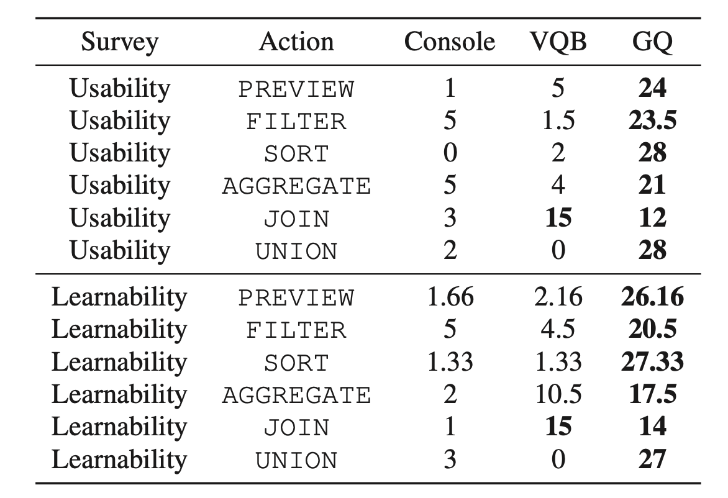
User Study
User Survey:
GestureQuery general outperforms Visual Query Builder and console
But - for JOIN: Usability/Learnability, VQB performs better
Notes:
As we can see from the table, most users find GESTUREQUERY easier to use by a large margin except for the JOIN action, where VISUAL QUERY BUILDER received 15 votes compared to GESTUREQUERY’s 12 for usability.
BUT, except for the JOIN operation, where GESTUREQUERY and VISUAL QUERY BUILDER received 14 and 15 votes respectively

Slide 20
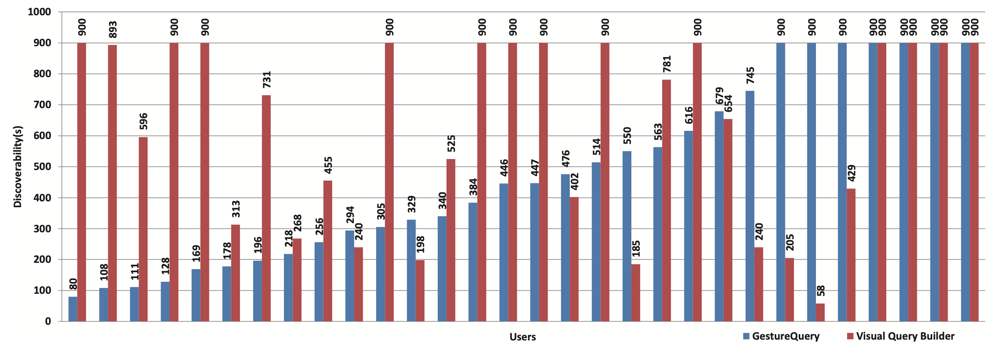
User Study
Discoverability (Task: PREVIEW, FILTER, and JOIN):
For majority of users, 23/30 completed task with GesturalQuery vs 17 for Visual Query Builder (and VQB was 19% slower)
Notes:
“What are the titles of the albums created by the artist ‘Black Sabbath’?”

Slide 21
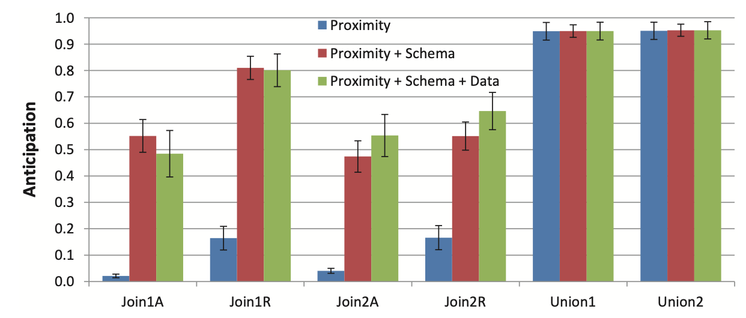
User Study
Anticipation (3 different classifiers on user intent):
First JOIN doesn’t benefit from data, nor UNIONs
Notes:
Using both proximity and schema compatibility features is better than just proximity in the all JOIN queries.

Slide 22
User Study
Percentage of touch classifications <= 33ms
Small delay loading into frontends Context Cache
Cache Performance
Compatibility & don’t recompute for proximity of incompatible attributes: 4x speedup in computation
Notes:
Top: Shows the interactivity results, the fraction of gestural inputs (movement of multitouch points on the device) that are classified within 33 ms, a threshold chosen based on the sampling rate of the multitouch sensor, which runs at 30 Hz
Bottom: The second optimization is to cache the computation of distances be- tween rectangles in the UI. This leads to an additional 23% speedup when the first optimization is active and a 32% speedup when it is not.

Slide 23
Discussion
Novice vs Advanced users: Difference in preference for Learning and Usability on JOIN. What happened?
Arc connections seemed confusing. Are JOINs (as done by UI-based systems) better? This is for novices after all…
The previews help to show if a JOIN makes sense. Those are executed with LIMITs. Is rapid user interaction going to cause significant slowdowns?
The UI seems to focus on dyads. Can this be adapted to support 3+ items?

Slide 24
Conclusion
Thank You!
(Thanks to Prof. Wu and Yiru for their help!)

Slide 26
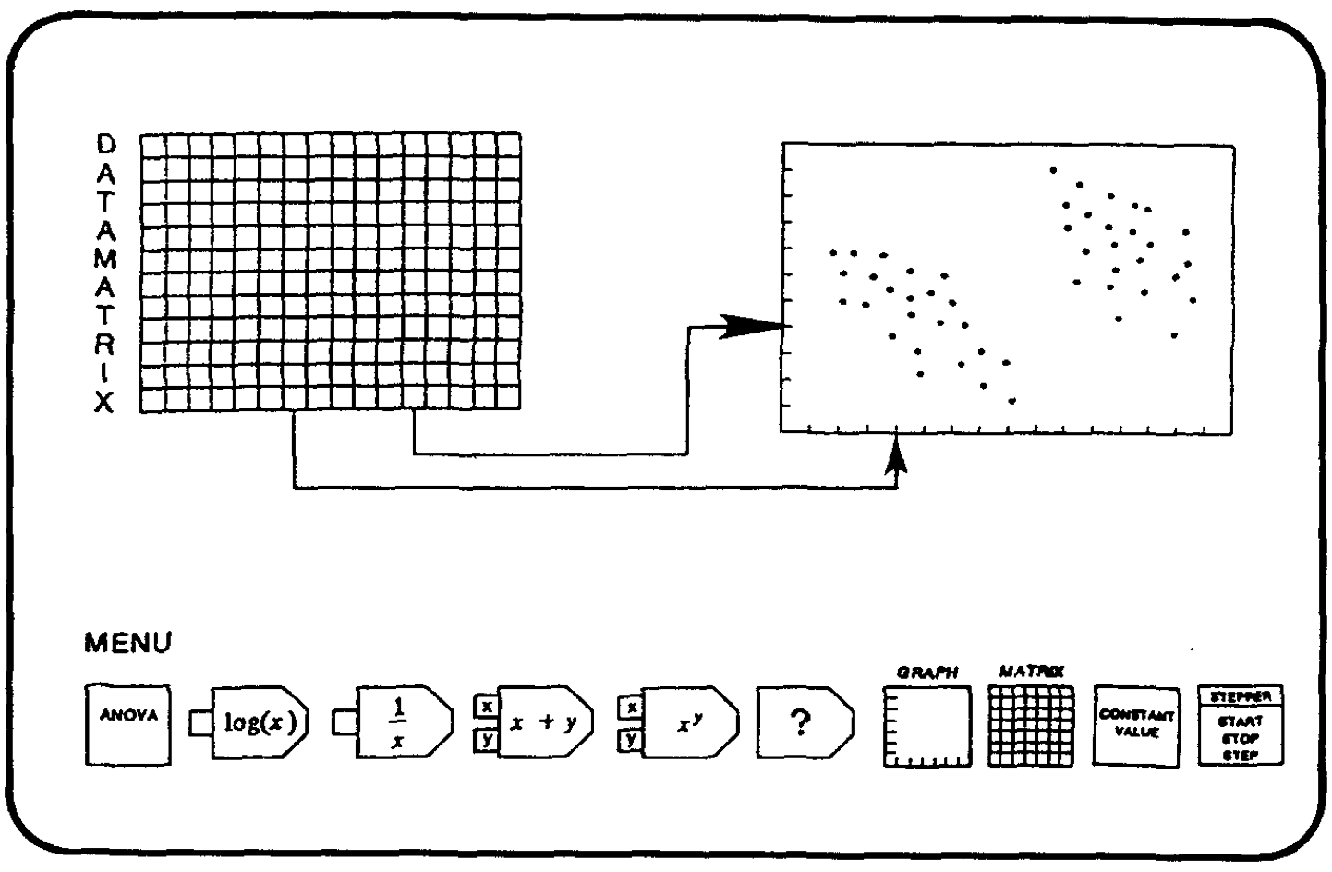
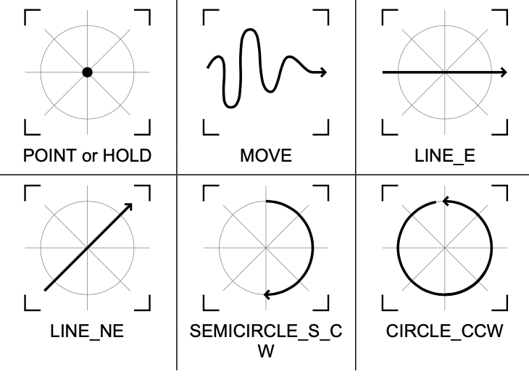
Related Work
Hutchins et al.: Direct Manipulation Interfaces (HCI 1985)
Cognitive considerations when interacting with interface elements directly
Kammer et al.: Towards a Formalization of Multi-touch Gestures (ITS 2010)
Strategies for simplifying the creation of new gestures
Hutchins, Edwin L., James D. Hollan, and Donald A. Norman. "Direct manipulation interfaces." Human–Computer Interaction 1.4 (1985): 311-338.
Kammer, Dietrich, et al. "Towards a formalization of multi-touch gestures." ACM International Conference on Interactive Tabletops and Surfaces. 2010.

Slide 27
GestureQuery Discussion

Slide 28
Student Questions
What gestures does Gesture Query start with?
Are they intuitive?
What do they assume about users that use GestureQuery?
Notes:
understand SQL query operators.

Slide 29
Issues with GestureQuery
When do gestures make querying harder?
Bigger schemas, larger tables.
Modal inputs better for values/params
Complex queries
Advanced users liked visual query builder

Slide 30
Experiments
What questions do you wish they answered?
Discoverability
Ease to compose queries

Slide 31
SpeakQL

Slide 32
The SpeakQL argument
People
know SQL. May even be experts
want to write SQL on-the-go
have a phone/tablet
Thus speech interface is best

Slide 33
Use Cases
DBA debugging system while on the road
Nurse accesses patient record away from his desk
Analyst answers customer sales question in a meeting

Slide 34
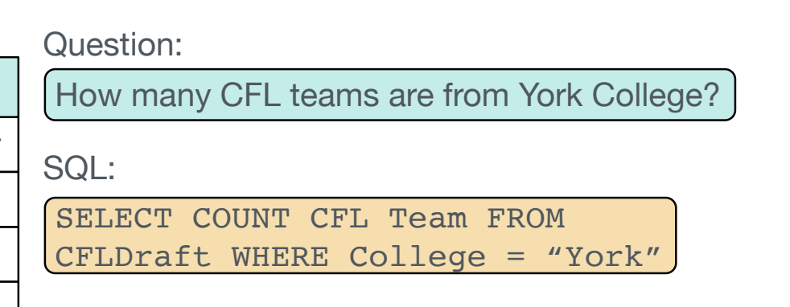
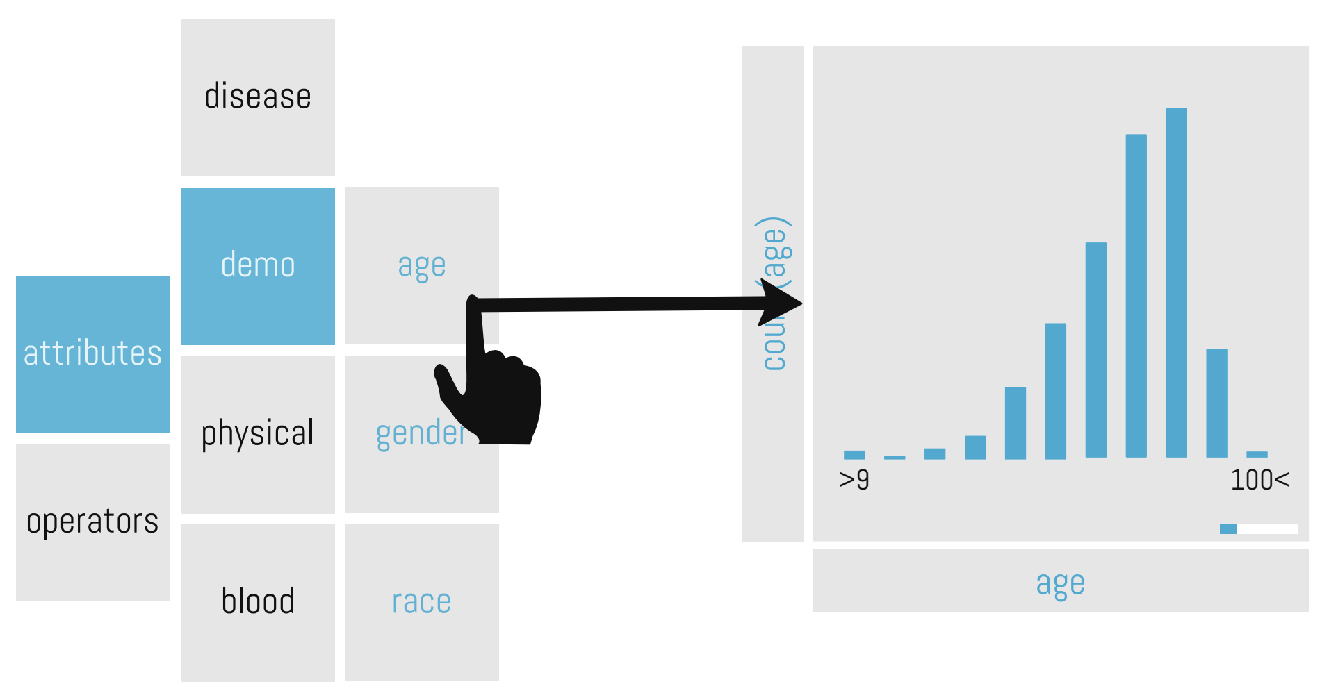
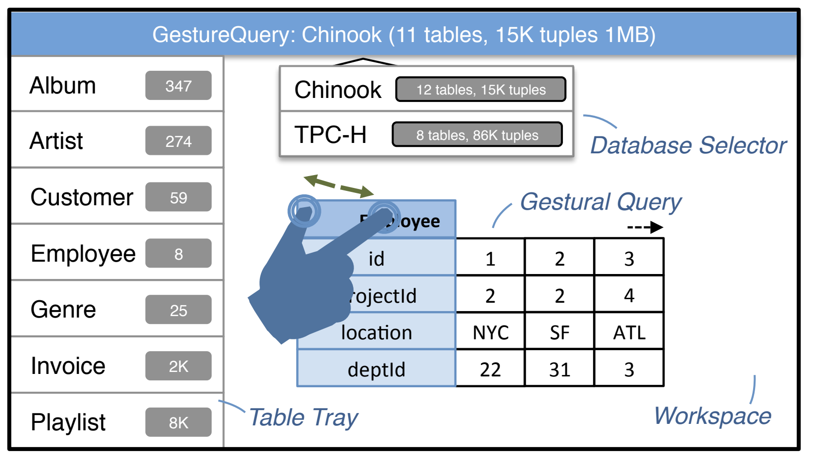
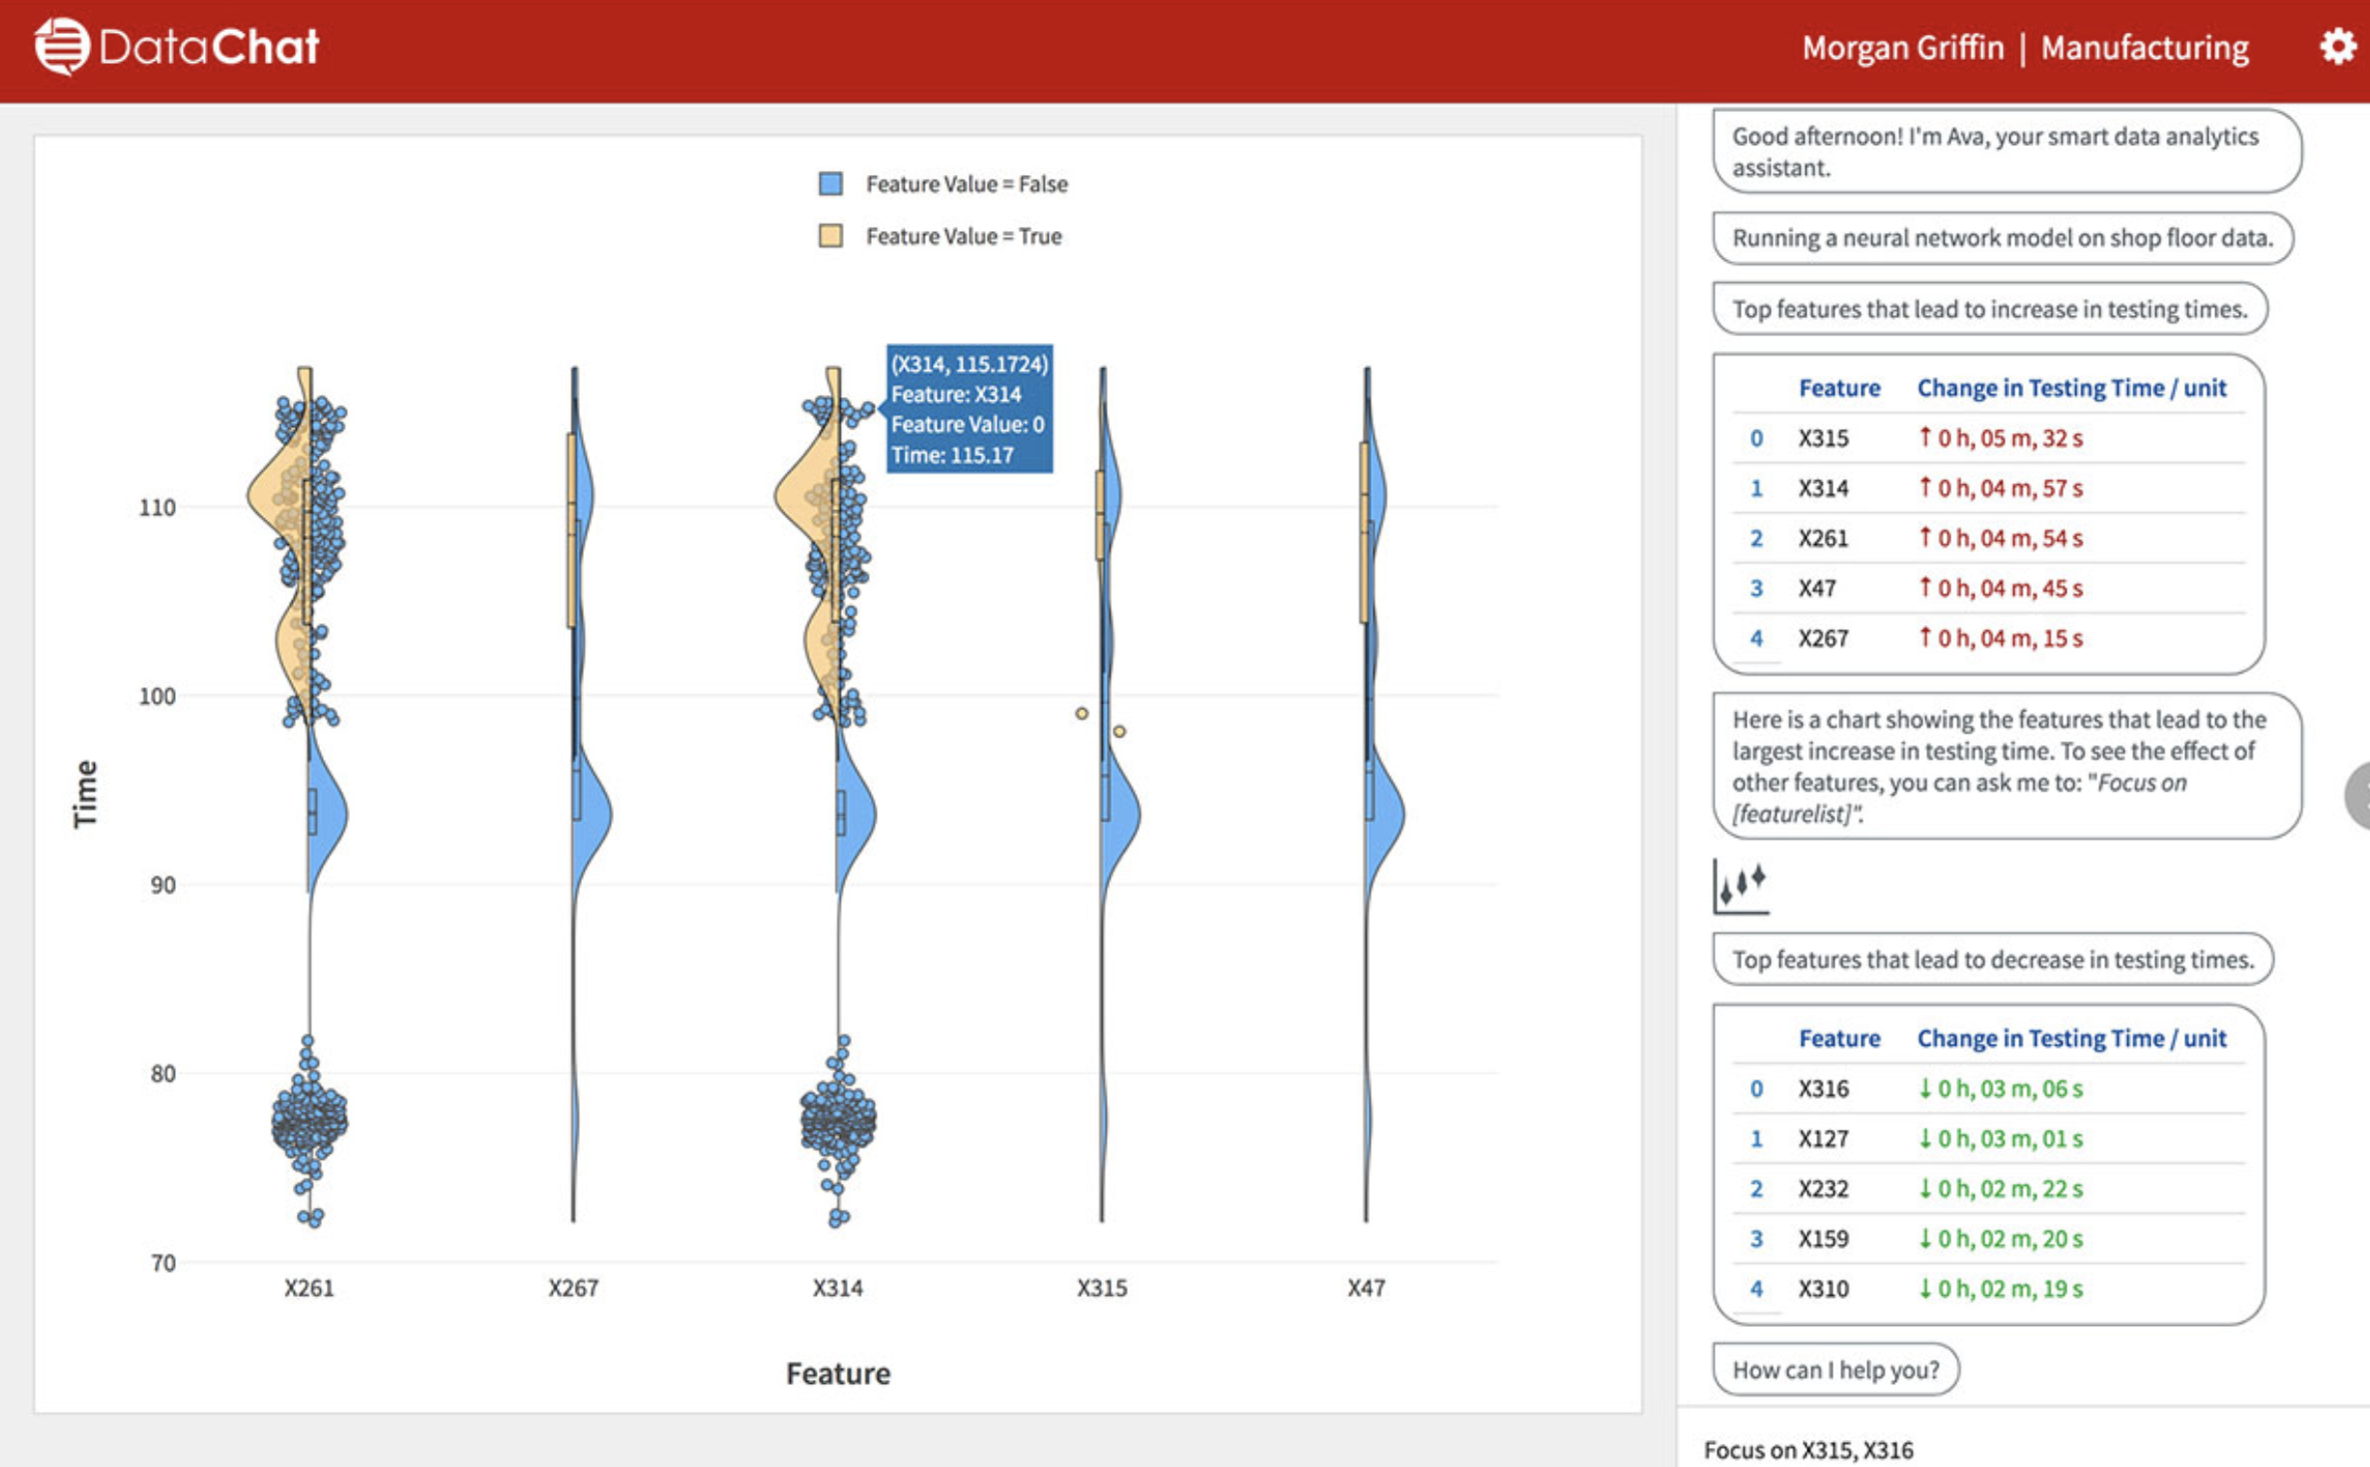
Why Not Existing Approaches?
Natural Language Interfaces (NLI)
User speech → ASR → NLI → SQL → result
Errors propagate in each step
Touch interfaces
Paper argues they “obviate” SQL
Template-based Interfaces
Seq2SQL
vizdom
gesturequery
DataChat

Slide 35
Approach Overview
Match speech tokens to SQL template (struct determination)
Fill in literals, address homophones (literal determination)

Slide 36
Structure Determination
Goal: find matching query template
Offline: build index of all possible query templates
Online: find minimum edit distance query template

Slide 37
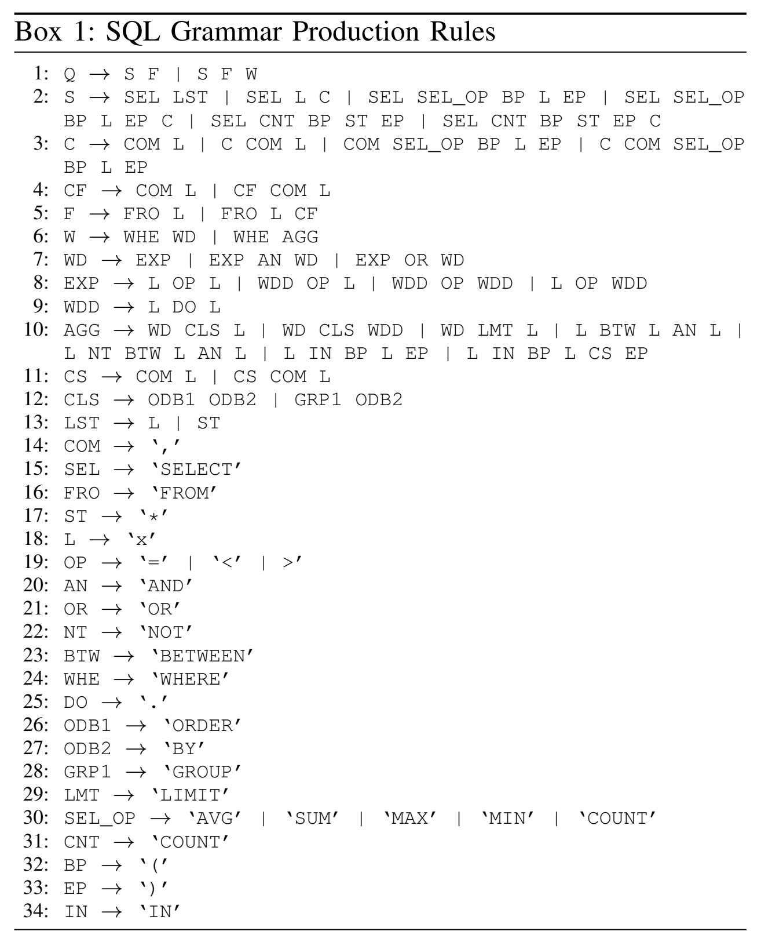
Offline
Generate all queries <=50 tokens
Build trie for queries of same length

Slide 38
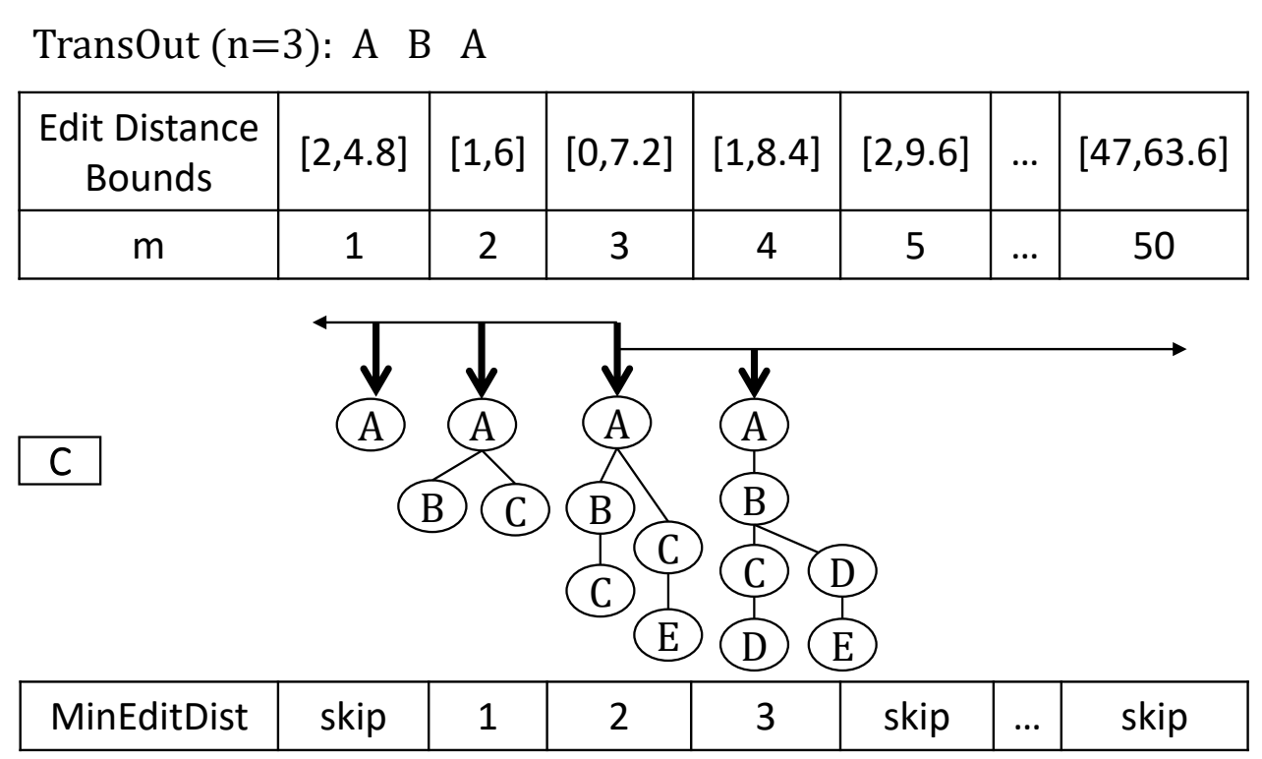
Online
Find template that matches
“select first name from employers wear col one two equal jon”
to
SELECT v1 FROM v2 WHERE v3 = v4
Match by edit distance
Bound & prune trick to speed up

Slide 39
Literal Determination
Fill in variables in query template based on sounds-like-ness
“select first name from employers wear col one two equal jon”
SELECT v1 FROM v2 WHERE v3 = v4
Ideas
Translate all tokens & values into phonemes. Employees → EMPLYS
Infer variable types from grammar. v1 is attr, v2 is table
Know tokens to variable mappings. “first name” → v1

Slide 40
Literal Determination
Tricky part: picking the attribute name/values
“first name” → “firstname”
“col one two” → “col_12”
What SpeakQL does
Enumerate all concatenations of tokens: ”first” “name” “firstname”
Compute phoneme distance with attributes “firstname”, “forestname”
All tokens get a “vote”
Thoughts on their method?

Slide 41
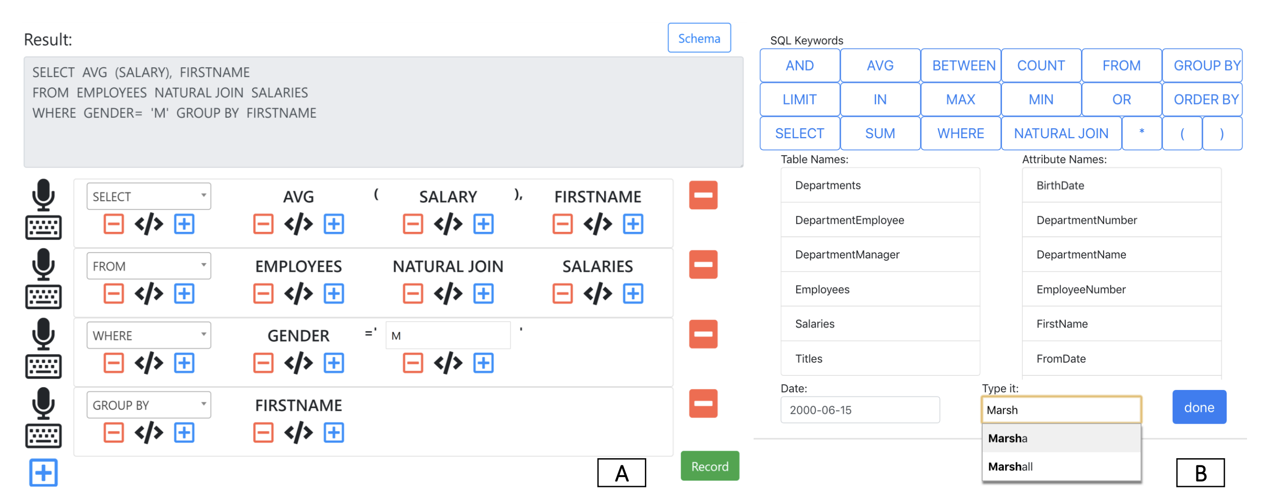
Experiments
Metrics
How accurate?
Did it get the tokens right?
Token edit distance
Easy to use?
Token edit distance
Time

Slide 42
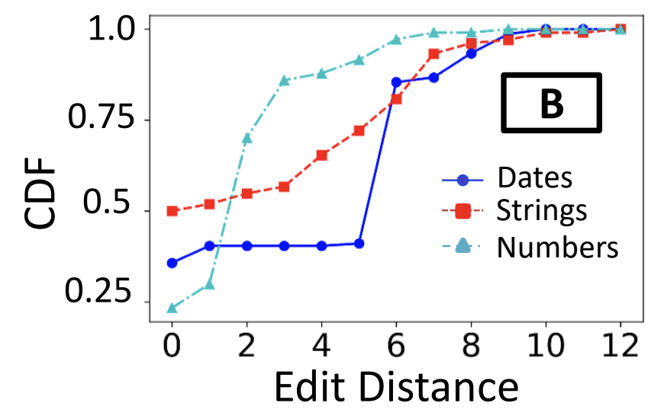
Synthetic Speech
Most within 5 tokens away from truth. Some within 25-30.
How complex are the queries? Does that matter?

Slide 43
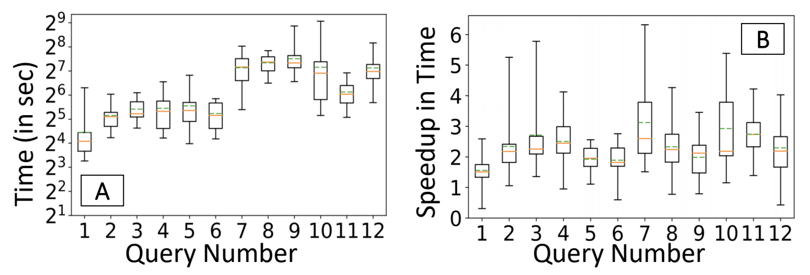
User Study
12 queries per user. 15 users
Simple: <20 token query
Complex: >= 20
Methods
SpeakQL
Mobile typing

Slide 44
Conclusions
SpeakQL works
Hard to compose entire query at once. Users think in “clauses”
Hard to disambiguate values – esp numbers and dates
Better than mobile keyboard typing.

Slide 45
SpeakQL Discussion

Slide 46
4 classes of questions
Wrong problem. Misunderstood user needs
Wrong abstraction. Showing the wrong thing
The way to show data is ineffective
Code is slow/buggy
Notes:
* early webvis papers soled "lost in hyperspace" by rendering the web's hyperlink topological structures. Not useful, and no idiom/algorithm could solve it, since it only added to user cognitive load

Slide 47
Thoughts on problem & abstraction?
Use case:
what do people want when querying data on-the-go?
Is speaking SQL the best way to query on-the-go?
Improvements/Alternatives?
Mobile-friendly SQL keyboard?
Custom app/visual analytics

Slide 48
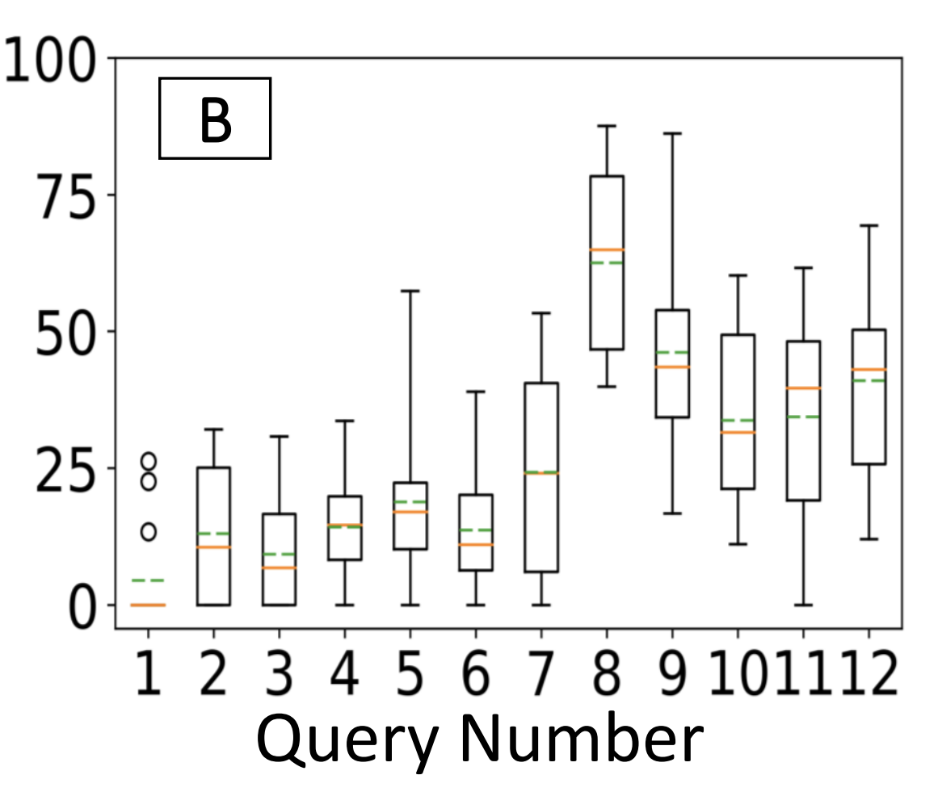
Issues with SpeakQL
Expressiveness
Select-Project-Join-Aggregate (up to 50 tokens)
Challenges if richer language?
debugging query structure harder if nesting is wrong
Intuitiveness
Easy to “debug” query?
Need to say “comma” in “SELECT a, b”
% time spent using keyboard

Slide 49
Experiments
Were the experiments “fair”?
Ran a pilot study – good idea!
Not clear what queries/tasks are evaluated
Type SQL using phone keyboard (hard!)

Slide 50
Comparing the Two Papers
GestureQuery: novices on tablets
SpeakQL: experts on phones
What are other users & settings ripe for interface development?
Users: SQL novices, SQL experts, ...?
Settings: exploration, adhoc queries, ...?

Slide 51
Comparing the Two Papers
Compare with Tableau
Tableau good at visual analytics and filter/aggregation
Less good at joins, selection
Compare with Excel
Excel good at projection, simple filters, sort
Less good at Joins, complex predicates, aggregation

